Slide 1
Unit 10 AC Voltage and Current
Part B: Description of an AC Waveform

Slide 2
What will you learn?
Parameters describe a sinusoidal waveform.
General equation for sinusoidal waveforms.
Conversion from radian to degree and vice versa.
Phase difference of two sinusoidal waveforms.
Average value and root mean square value (rms) of a sinusoidal waveform.

Slide 3
Parameters of a Sinusoidal Waveform
AC voltage and AC current are both sinusoidal waveforms.
We will focus on sinusoidal voltages to learn more about AC waveform.
A sinusoidal waveform has its magnitude that varies as a sine function.
A sinusoidal waveform can be represented by an equation of a sine function.

Slide 4

Parameters of a Sinusoidal Waveform
0
–
+
$$v(t)$$
0
time

Slide 5
Parameters of a Sinusoidal Waveform
voltage
Period T
Peak value V_{p}
0
time
Peak-to-peak value V_{pp}
Period T
Period T
Sinusoidal waveform is periodic waveform.
A periodic waveform repeats itself cycle after cycle.
A cycle can start anywhere. It ends when reaching back the same level.

Slide 6


Parameters of a Sinusoidal Waveform
Period is the duration to complete 1 cycle of sine wave.
Its symbol is T.
Its unit of measurement is in second (s).
$$v(t)$$
1 cycle
0
time
Period T
The number of complete cycles in one second is called frequency.
Its symbol is f.
Its unit of measurement is the hertz, (Hz).
$$f=\frac{1}{T}$$

Slide 7




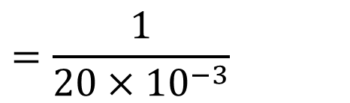

Example 1: Determine (a) period and (b) frequency of the sinusoidal waveform.
(a) Period T = 20 ms
$v(t)$ (V)
$$\left(b\right) Frequency f=\frac{1}{T}$$
0.5
$$=\frac{1}{20×{10}^{−3}}$$
0
10
20
30
t (ms)
$$=50 Hz$$
−0.5

Slide 8

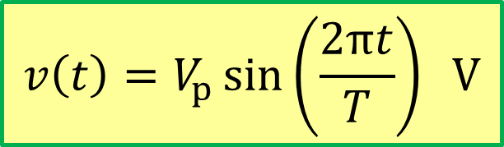

Parameters of a Sinusoidal Waveform
$$v(t)$$
Peak value V_{p}
Period T
0
time
Peak-to-peak value V_{pp}
Period T
Period T
Sine wave function:
$$v\left(t\right)=V_{p}\sin\left(\frac{2πt}{T}\right) V$$
$$v\left(t\right)=V_{p}\sin\left(2πft\right) V$$
or

Slide 9


Parameters of a Sinusoidal Waveform
Peak voltage value V_{p} is the maximum positive value.
It is also called the amplitude of the waveform.
Negative peak voltage value is −V_{p}.
$$v(t)$$
Peak value V_{p}
0
time
−V_{p}
Peak-to-peak value V_{pp}
V_{pp} is the peak-to-peak voltage measured between the two peaks.
Note that:
$$V_{pp}=2V_{p}$$

Slide 10


Example 2: Determine the value of: (a) peak voltage, and (b) peak-to-peak voltage of the sinusoidal waveform.
(a) Peak voltage V_{p} = 0.5 V
$v(t)$ (V)
(b) Peak-to-peak voltage
0.5
$$V_{pp}=2×0.5 V=1 V$$
0
10
20
30
t (ms)
−0.5

Slide 11


Example 3: Write the sine wave equation of the waveform $v\left(t\right)$ below.
The general equation is
$$v\left(t\right)=V_{p}\sin\left(2πft\right)$$
$$=V_{p} sin\left(\frac{2πt}{T}\right)$$
$$=0.5 sin\left(\frac{2πt}{20×{10}^{−3}}\right)$$
$$=0.5 sin\left(2π×50×t\right)$$
$$=0.5 sin\left(100πt\right) V$$
$v(t)$ (V)
0.5
0
10
20
30
t (ms)
−0.5

Slide 12




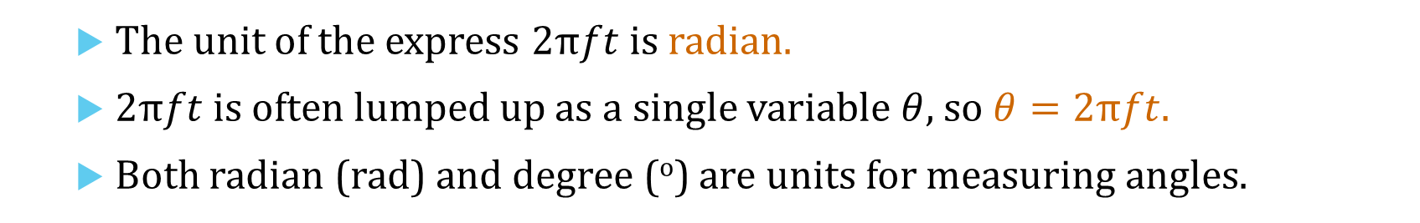


Parameters of a Sinusoidal Waveform
$$v\left(t\right)=V_{p}\sin\left(2πft\right)$$
$$v\left(θ\right)=V_{p}\sin\left(θ\right)$$
$$v(t)$$
Peak value V_{p}
0
$$t$$
$$θ$$
Period T
$$2πft=2π\frac{t}{T}$$
The unit of the express $2πft$ is radian.
$2πft$ is often lumped up as a single variable $θ$, so $θ=2πft.$
Both radian (rad) and degree (º) are units for measuring angles.

Slide 13
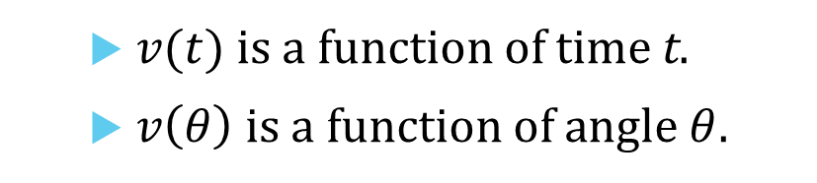





Instantaneous values of a Sinusoidal Waveform
At any point in time, voltage in a sine wave has an instantaneous value.
Value is different at different point on the curve.
Instantaneous value is given by
$$v(t)$$
v₃
v₂
v₁
t₄ t₅ t₆
$$v\left(t\right)=V_{p}\sin\left(2πft\right) V$$
0
t₁ t₂ t₃
time
−v₄
Or, in terms of angle $θ$
−v₅
$$v\left(θ\right)=V_{p}\sin\left(θ\right) V$$
−v₆
$$θ=2πft radian$$
$v(t)$ is a function of time t.
$v\left(θ\right)$ is a function of angle $θ$.

Slide 14
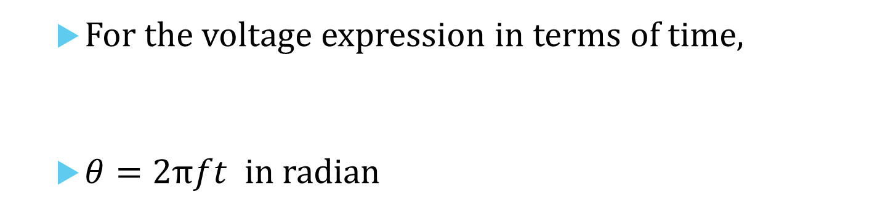




Converting angle from radian to degree
For the voltage expression in terms of time,
$θ=2πft$in radian
$$v\left(t\right)=V_{p}\sin\left(2πft\right)$$
$$∵π rad=180 degrees$$
$$∴1 rad=\frac{180}{π} degrees$$
$$∴ θ rad=θ×\frac{180}{π} degrees$$

Slide 15
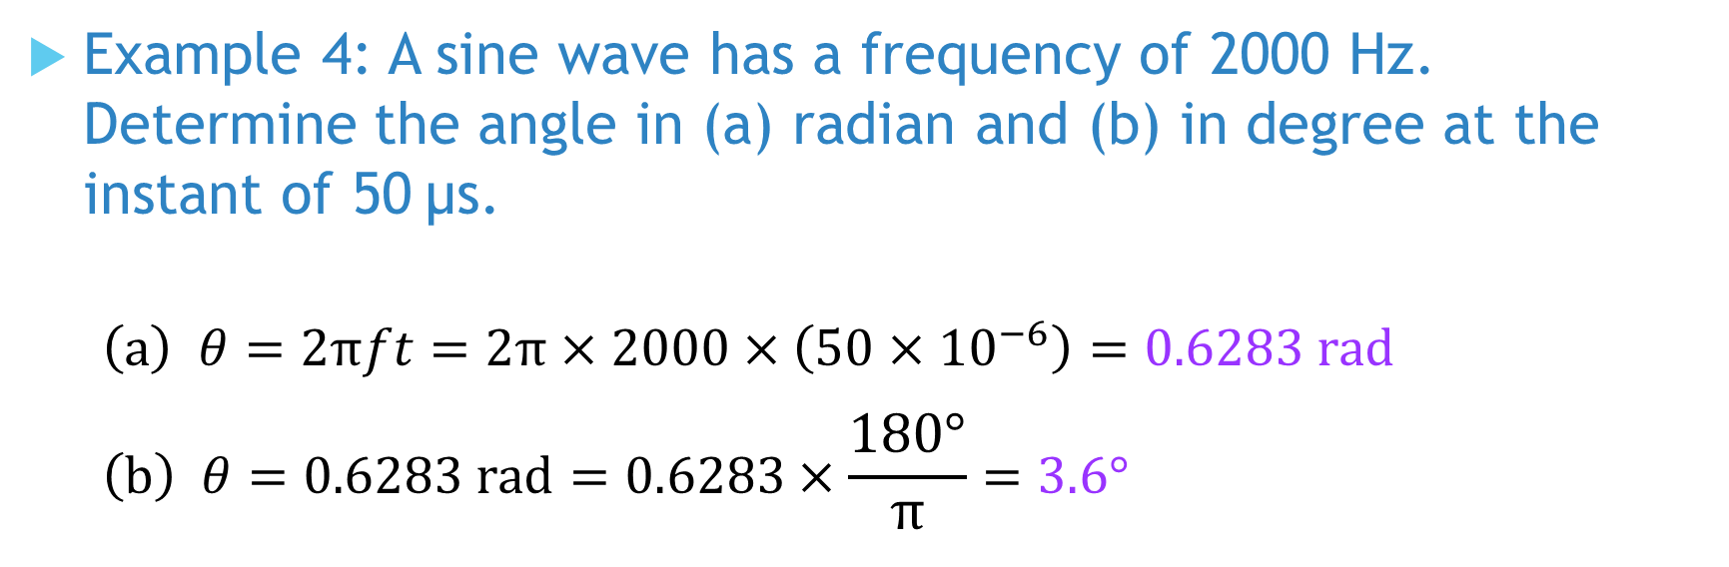
Example 4: A sine wave has a frequency of 2000 Hz. Determine the angle in (a) radian and (b) in degree at the instant of 50 µs.
$$\left(a\right) θ=2πft=2π×2000×\left(50×{10}^{−6}\right)=0.6283 rad$$
$$\left(b\right) θ=0.6283 rad=0.6283×\frac{180°}{π}=3.6°$$

Slide 16



Converting angle from degree to radian
$$∵180 degrees=π rad$$
$$∴1 degree=\frac{π}{180} rad$$
$$∴ θ degrees=θ×\frac{π}{180} rad$$

Slide 17
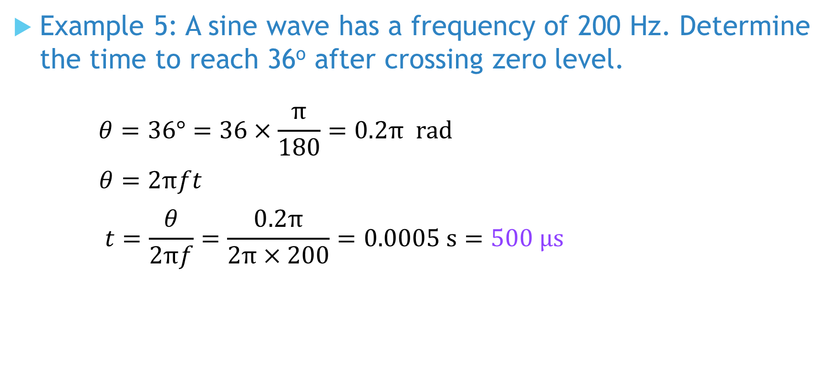
Example 5: A sine wave has a frequency of 200 Hz. Determine the time to reach 36º after crossing zero level.
$$θ=36°=36×\frac{π}{180}=0.2π rad$$
$$θ=2πft$$
$$t=\frac{θ}{2πf}=\frac{0.2π}{2π×200}=0.0005 s=500 μs$$

Slide 18
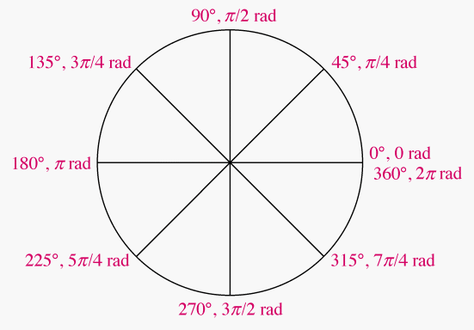
Angle in Degree and Its Equivalent Radian
Therefore, an angular position can be represented
in degree (º), or in radian (rad)

Slide 19


Example 6: Write down the sinusoidal equation of the waveform.
The general expression is
$$v\left(t\right)=V_{p}\sin\left(2πft\right)$$
Given that V_{p} = 300 V
Time to complete 10 cycles = 0.2 s
$$Period T=\frac{0.2 s}{10 cycles}=20 ms$$
$$Frequency f=\frac{1}{T}=\frac{1}{20×{10}^{−3}}=50 Hz$$
$$v\left(t\right)=300\sin\left(2π×50×t\right)$$
$$=300 sin\left(100πt\right) V$$
$v\left(t\right)$ (V)
V_{p} = 300 V
0
t (s)
0.1
0.2

Slide 20

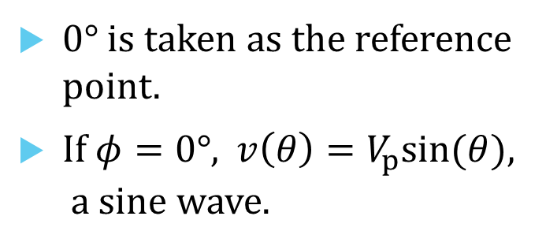

Phase $φ$ of a Sine Wave
The general equation of a sine wave with a phase angle of $±φ$ is
$$v\left(θ\right)=V_{p}\sin\left(θ±φ\right) V$$
Phase is an angular measurement specifying the position of a sine wave relative to a reference.
$$v(θ)$$
0° is taken as the reference point.
If $φ=0°$, $v\left(θ\right)=V_{p}sin(θ)$, a sine wave.
Positive peak (90°)
Negative-going
zero crossing at 180º
Positive-going
zero crossing at 0º
0
0°
90°
180°
270°
360°
θ
(π/2)
(π)
(3π/2)
(2π)
Negative peak (270°)

Slide 21





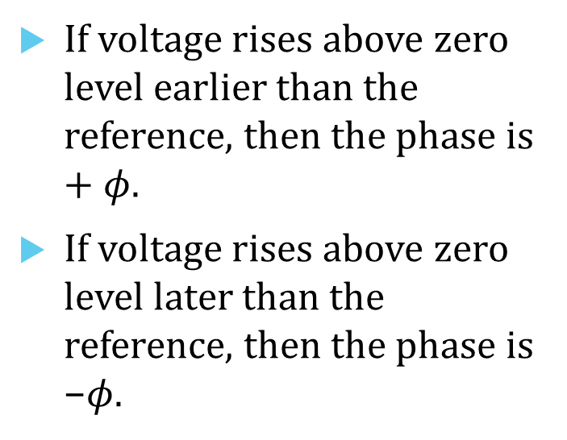


Phase $φ$ of a Sine Wave
The general equation of a sine wave with a phase angle $±φ$ is
$$v\left(θ\right)=V_{p}\sin\left(θ±φ\right) V$$
V_{p}
If voltage rises above zero level earlier than the reference, then the phase is $+φ$.
If voltage rises above zero level later than the reference, then the phase is −$φ.$
$$v\left(θ\right)=V_{p}\sin\left(θ+φ\right) V$$
0°
90°
180°
270°
360°
$$θ$$
$$φ$$
V_{p}
$$v\left(θ\right)=V_{p}\sin\left(θ−φ\right) V$$
0°
90°
180°
270°
360°
$$θ$$
$$φ$$

Slide 22

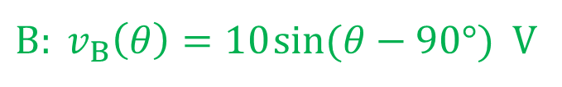
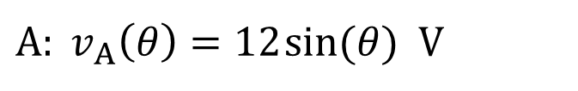

Phase Difference between Sine Waves
Waveform A rises above zero level 90° earlier than Waveform B.
$$v\left(θ\right)$$
$A: v_{A}\left(θ\right)=12 sin(θ)$ V
A leads B by 90°.
B lags A by 90°.
$B: v_{B}\left(θ\right)=10 sin(θ−90°)$ V
12 V
A
10 V
B
0
$$θ$$
0°
90°
180°
270°
360°

Slide 23
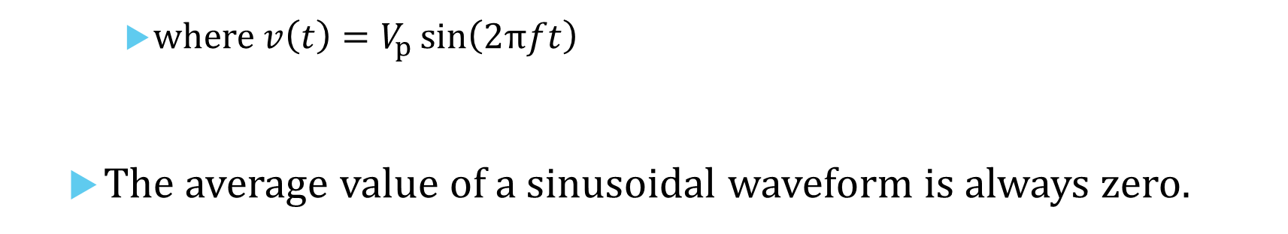


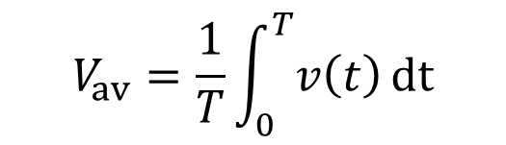
Values Associated with Sinusoidal Waveform
Average voltage over a full cycle
$$V_{av}=\frac{1}{T}\int_{0}^{T}{v\left(t\right) dt}$$
$$v\left(t\right)$$
Average value V_{av}
where $v\left(t\right)=V_{p}\sin\left(2πft\right)$
The average value of a sinusoidal waveform is always zero.
0
time
$$V_{av}=0$$

Slide 24
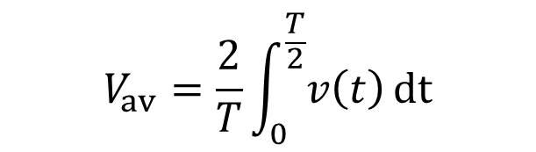
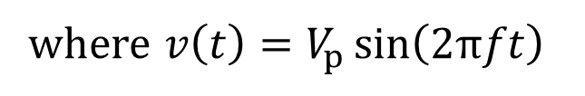
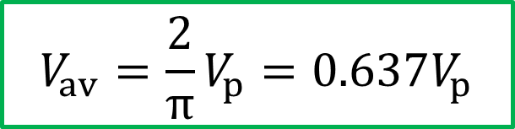
Values Associated with Sinusoidal Waveform
Average voltage over a positive half cycle
$$V_{av}=\frac{2}{T}\int_{0}^{\frac{T}{2}}{v\left(t\right) dt}$$
Peak value V_{p}
Average value V_{av}
where $v\left(t\right)=V_{p}\sin\left(2πft\right)$
0
time
The average value over a positive half cycle of a sinusoidal waveform is
$$V_{av}=\frac{2}{π}V_{p}=0.637V_{p}$$

Slide 25
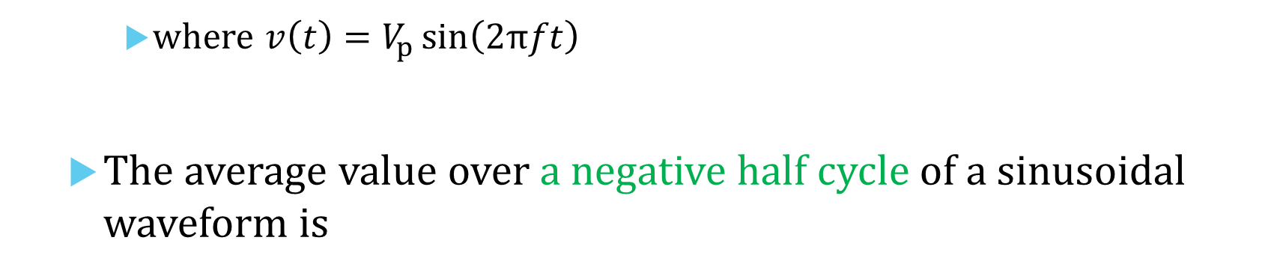

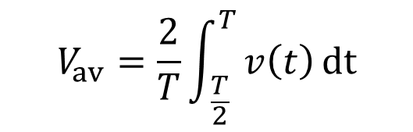
Values Associated with Sinusoidal Waveform
Average voltage over a negative half cycle
$$V_{av}=\frac{2}{T}\int_{ \frac{T}{2}}^{T}{v\left(t\right) dt}$$
Average value V_{av}
0
time
where $v\left(t\right)=V_{p}\sin\left(2πft\right)$
The average value over a negative half cycle of a sinusoidal waveform is
Peak value −V_{p}
$$V_{av}=−\frac{2}{π}V_{p}=−0.637 V_{p}$$

Slide 26



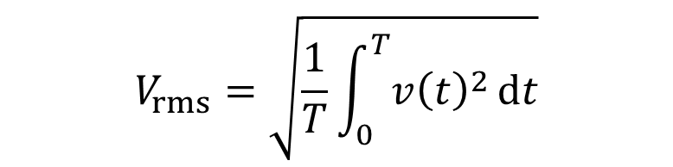
Values Associated with Sinusoidal Waveform
Root Mean Square (rms) voltage
$$V_{rms}=\sqrt{\frac{1}{T}\int_{0}^{T}{{v\left(t\right)}^{2} dt}}$$
rms value V_{rms}
$$v\left(t\right)$$
Peak value V_{p}
0
where $v\left(t\right)=V_{p}\sin\left(2πft\right)$
The rms value of a sinusoidal waveform is
time
$$V_{rms}=\frac{V_{p}}{\sqrt{2}}=0.707V_{p}$$

Slide 27
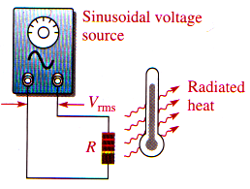
V_{rms} as a Measure of Heating Effect
V_{rms} of a sinusoidal waveform = V_{dc} that produces the same amount of heating in a resistor.
Suppose we have an ac setup as shown in Part (a)
We set the voltage to 50 V_{rms} .
We record the temperature as an indicator of the heat radiated.
Part (a)
50 volts in rms

Slide 28
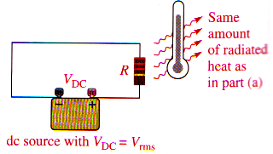
V_{rms} as a Measure of Heating Effect
V_{rms} of a sinusoidal waveform = V_{dc} that that produces the same amount of heating in a resistor.
Now we have a dc setup as shown in Part (b).
We vary the V_{dc} until the same temperature reached as in Part (a).
We will find
V_{rms} = V_{dc}
V_{dc}
Part (b)
V_{dc}

Slide 29
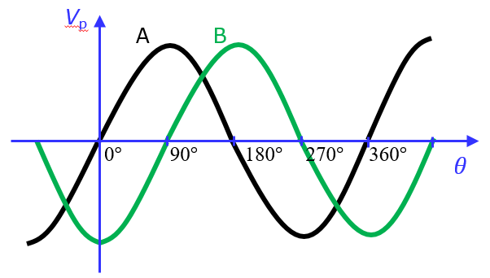
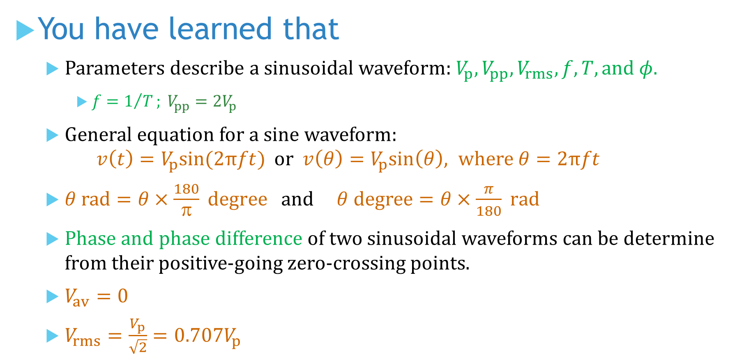
You have learned that
Parameters describe a sinusoidal waveform: $V_{p}, V_{pp}, V_{rms}, f, T, and φ$.
$f=1/T; V_{pp}={2V}_{p}$
General equation for a sine waveform: $v\left(t\right)=V_{p}sin(2πft)$ or $v\left(θ\right)=V_{p}sin\left(θ\right), where θ=2πft$
$θ rad=θ×\frac{180}{π} degree$ and $θ degree=θ×\frac{π}{180} rad$
Phase and phase difference of two sinusoidal waveforms can be determine from their positive-going zero-crossing points.
$V_{av}=0$
$V_{rms}=\frac{V_{p}}{\sqrt{2}}=0.707V_{p}$

Slide 30
Coming Up Next
AC Circuit Analysis

